Slide 1

SDN302: FINAL PROJECT PRESENTATION
Yu-Gi-Oh! Card Market & Deck Builder
(YGO-MARKET)

Slide 2
Project Overview
YGO-MARKET is a full-stack MERN platform for Yu-Gi-Oh! TCG/OCG players and collectors. It combines local card lookup with 5-market price tracking (TCGplayer, Cardmarket, eBay, Amazon, CoolStuffInc), automated daily sync via node-cron, multi-tier EN/VI card effect translation cached in MongoDB, a curated deck library with .ydk export, and TCG/OCG/GOAT banlists.
Tech Stack: MongoDB + Mongoose 8.9 | Express 4.21 + Node.js | React 18.3 + Vite 6.1
Core System Modules (Repository Author: Haruto2711 — SDN302):
• Auth & Profile: scrypt sign-in, Favorites collection & total min-price valuation
• Card Catalog & Prices: Daily 00:00 node-cron sync & self-hosted card artwork cache
• Bilingual EN/VI Translator: Multi-tier PSCT/glossary pipeline cached in Card.desc_vi
• Deck Library & Banlists: Archetype filters, .ydk export & TCG/OCG/GOAT tiers
• Admin Governance Portal: Role-gated dashboard stats & Card / Price / Deck / User CRUD

Slide 3
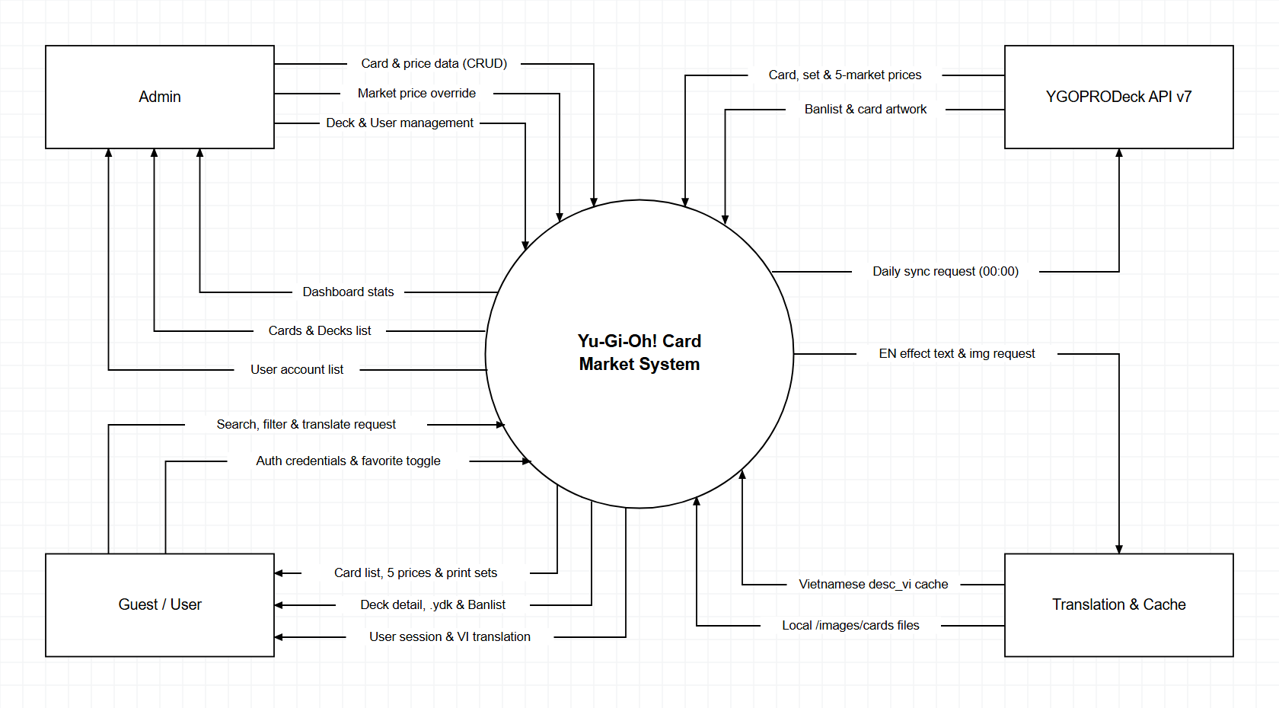
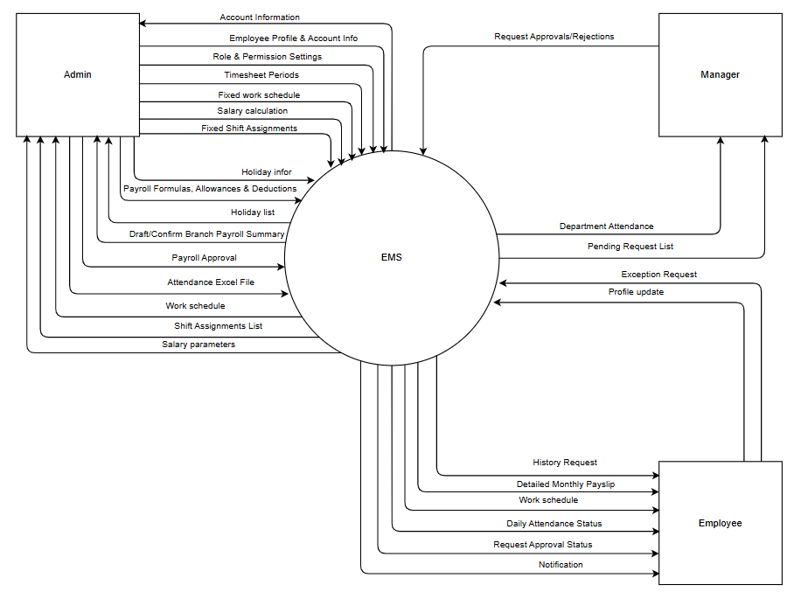
Context Diagram

Slide 4
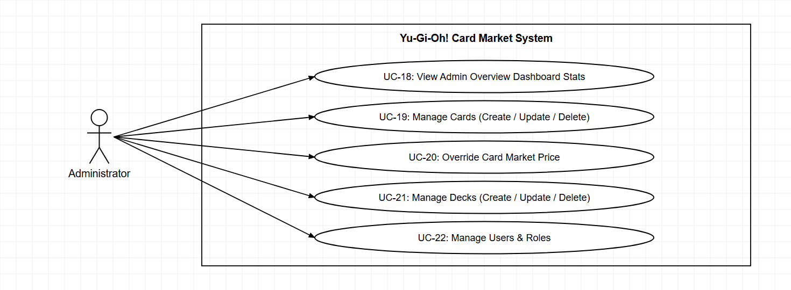
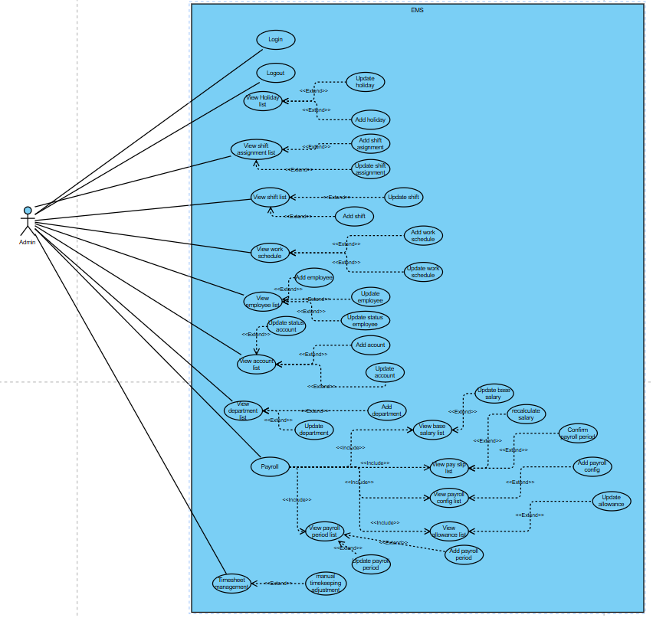
Product Requirements
Use Case Diagrams
Admin

Slide 5
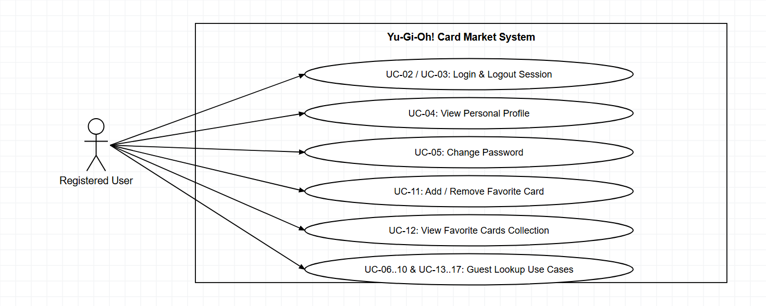
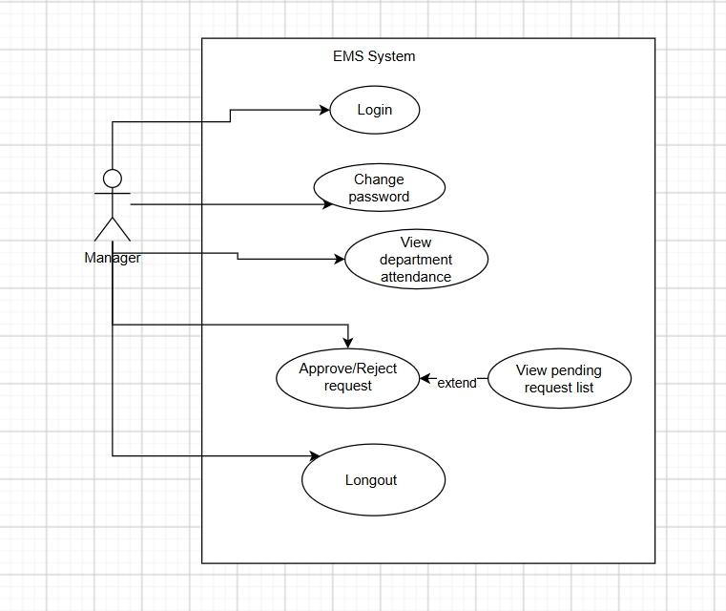
Product Requirements
Use Case Diagrams
Registered User

Slide 6
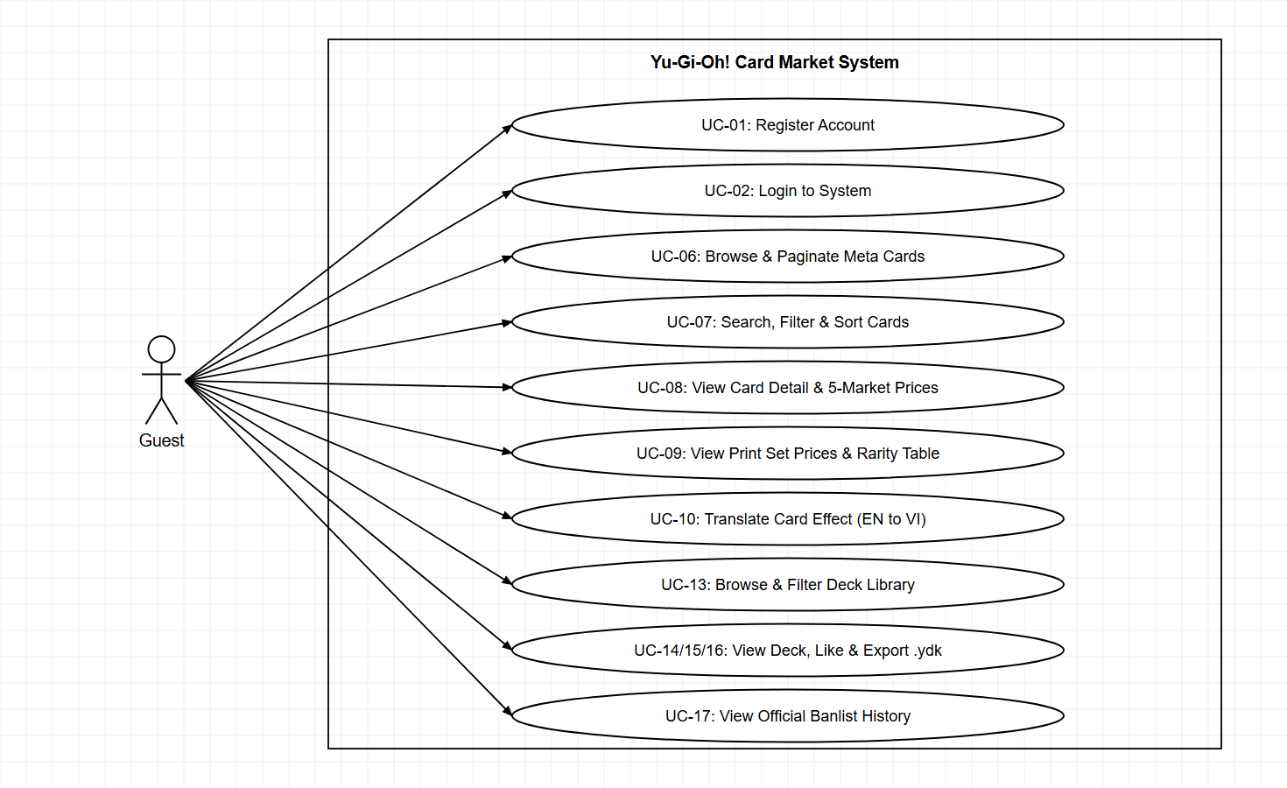
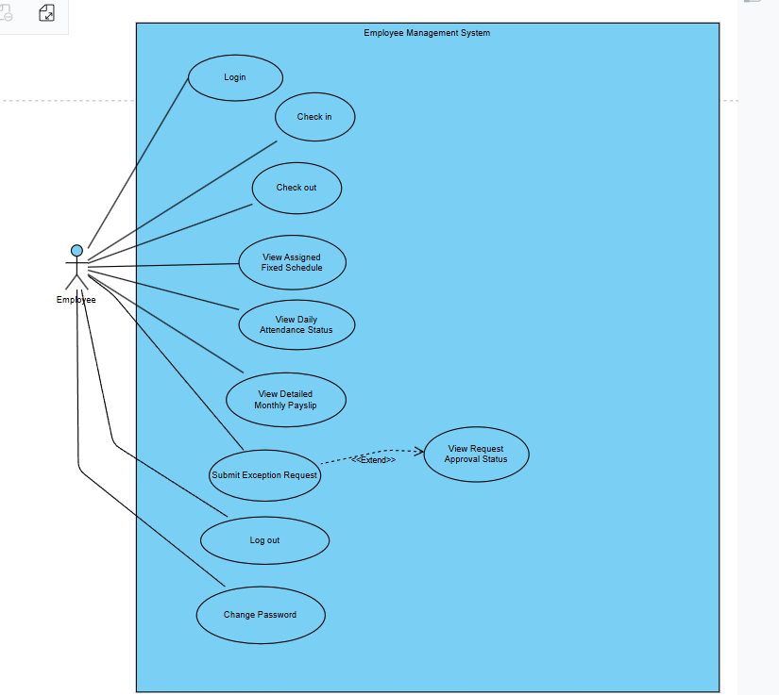
Product Requirements
Use Case Diagrams
Guest

Slide 7
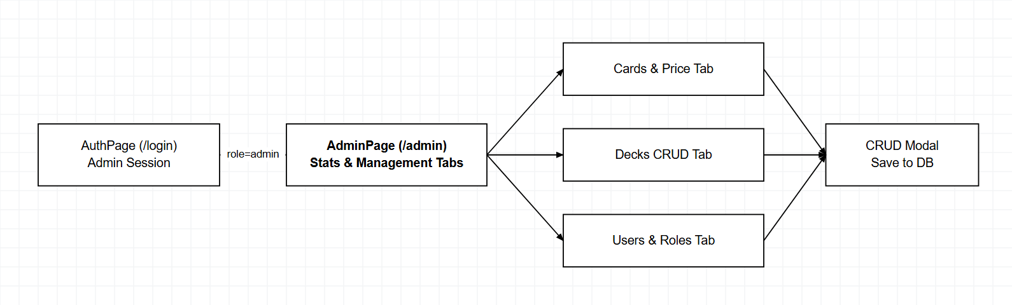
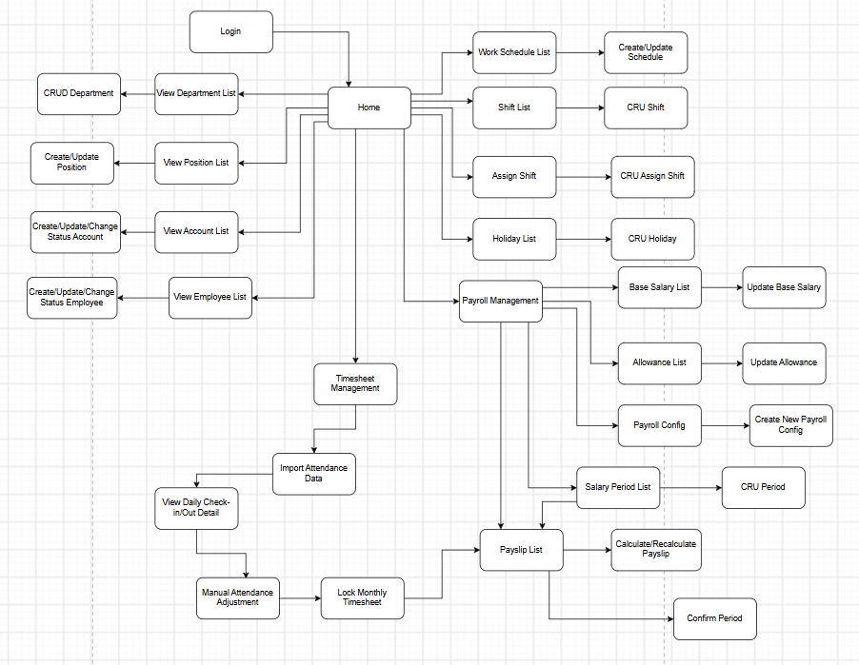
Product Requirements
Product Functionalities
Admin Screen Flow

Slide 8
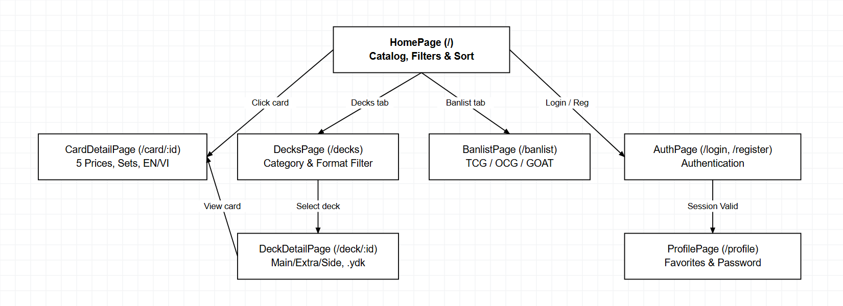
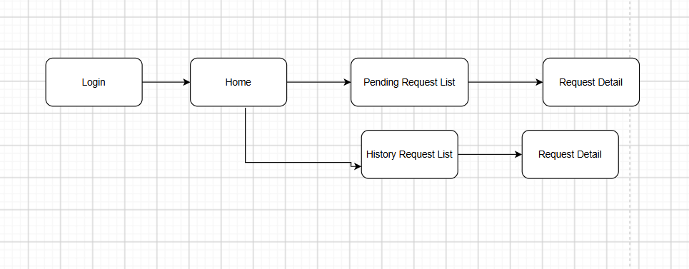
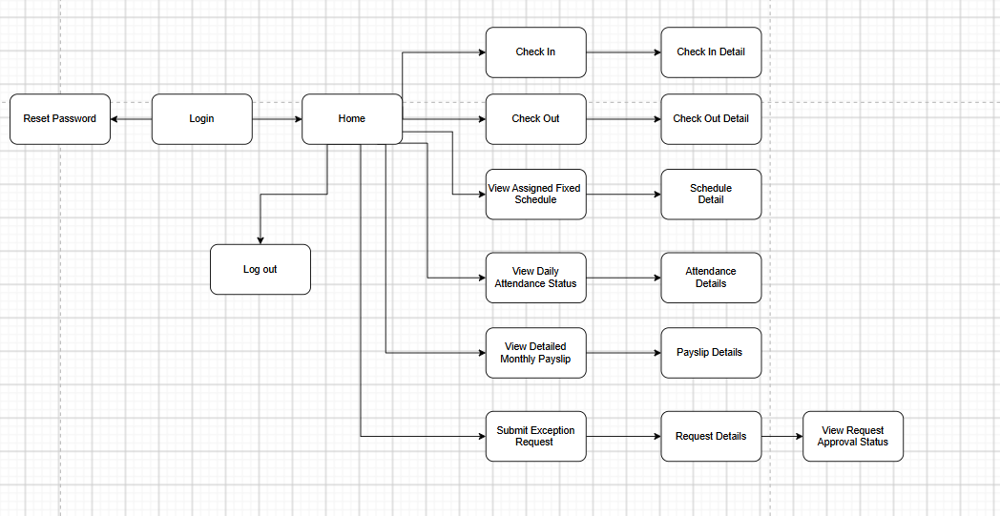
Product Requirements
Product Functionalities
Guest & Registered User Screen Flow

Slide 9
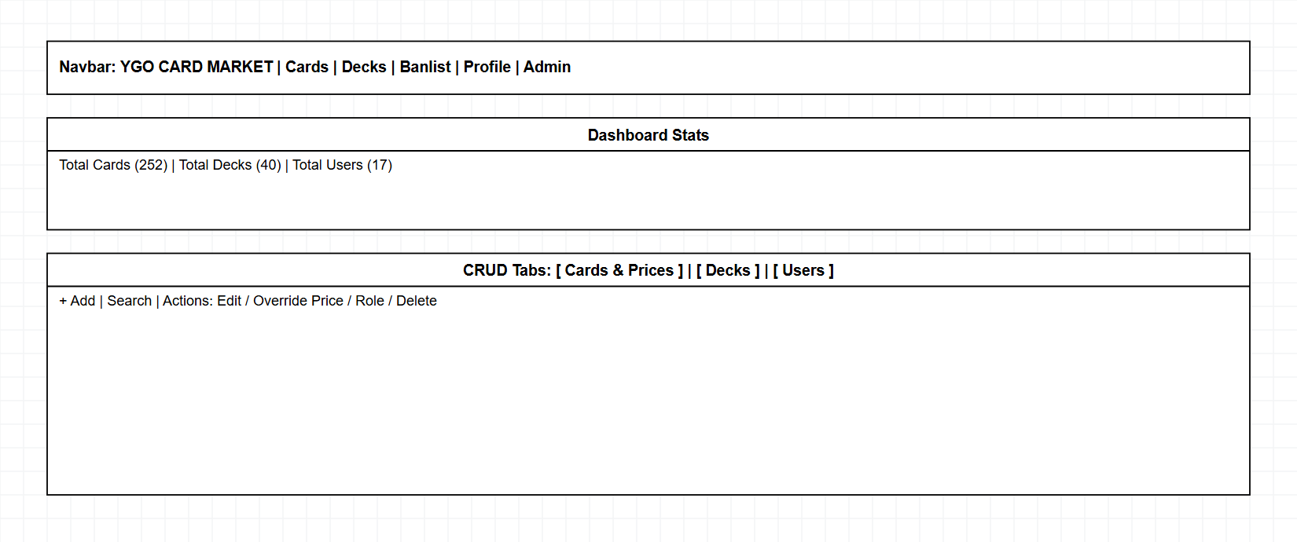
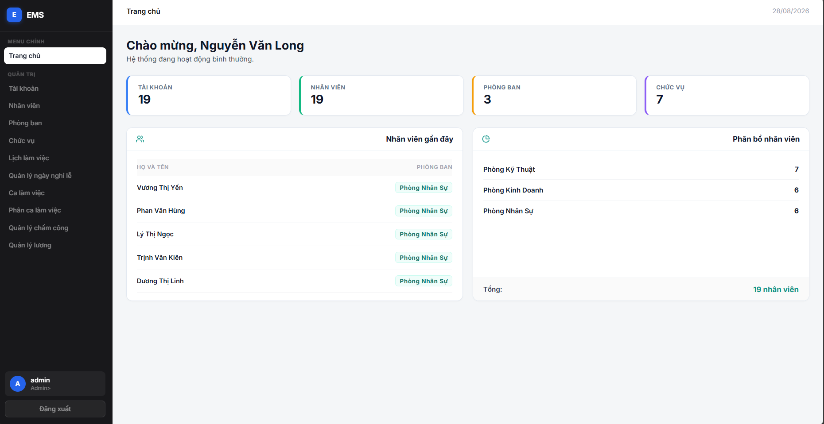
Product Requirements
Main Screen UI Design
Admin Dashboard & Card/User CRUD Screen

Slide 10
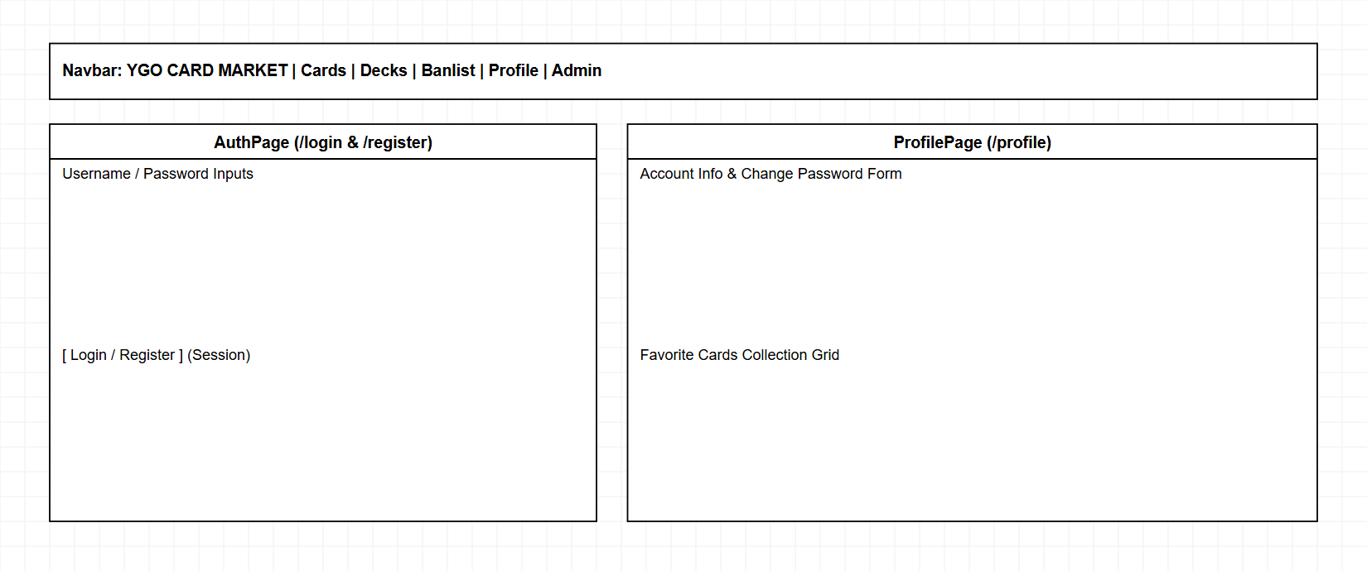
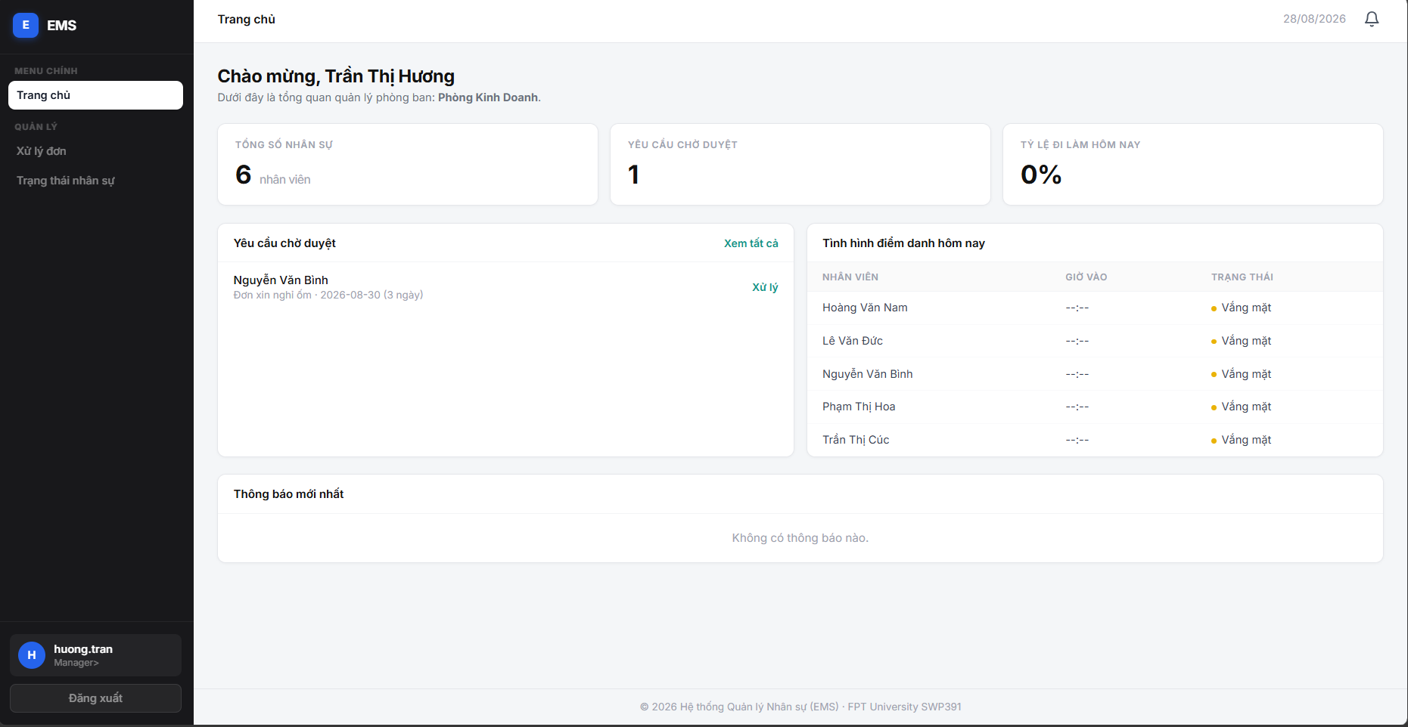
Product Requirements
Main Screen UI Design
Login, Registration & User Profile Screens

Slide 11
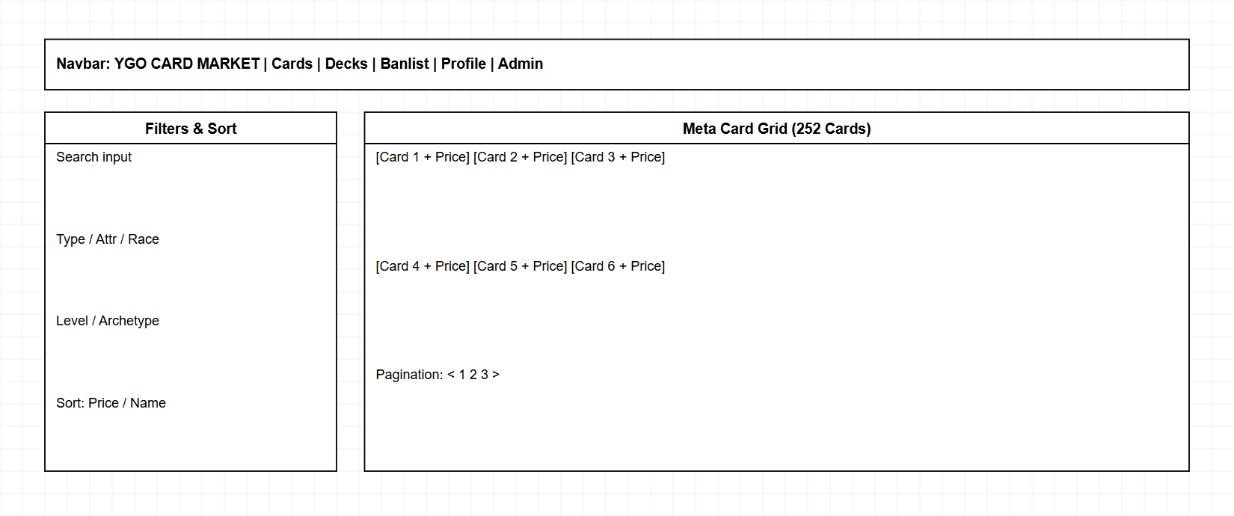
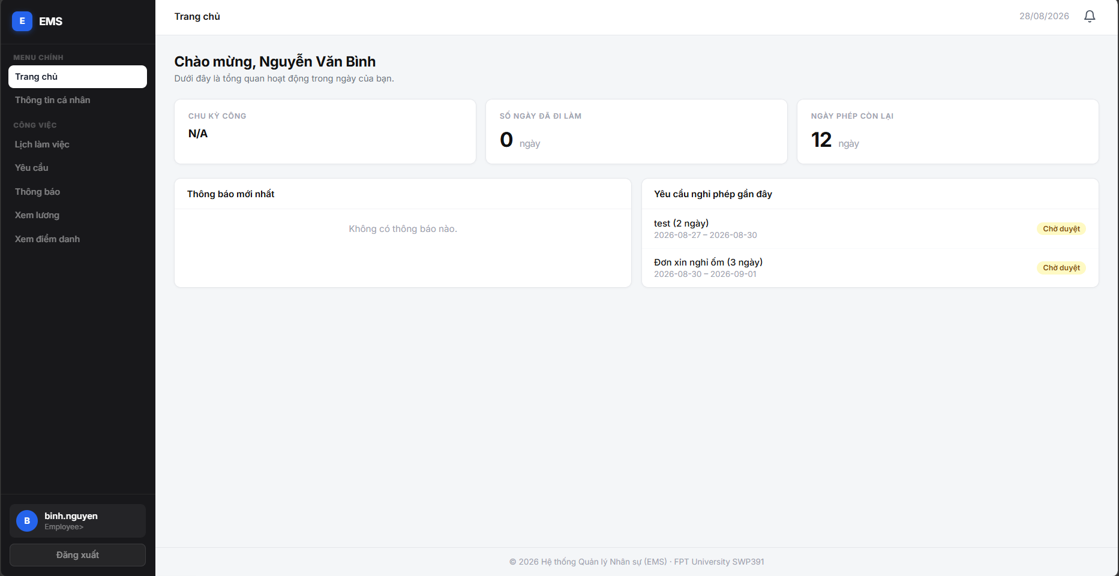
Product Requirements
Main Screen UI Design
Public Card Catalog & Deck Builder Entry UI

Slide 12
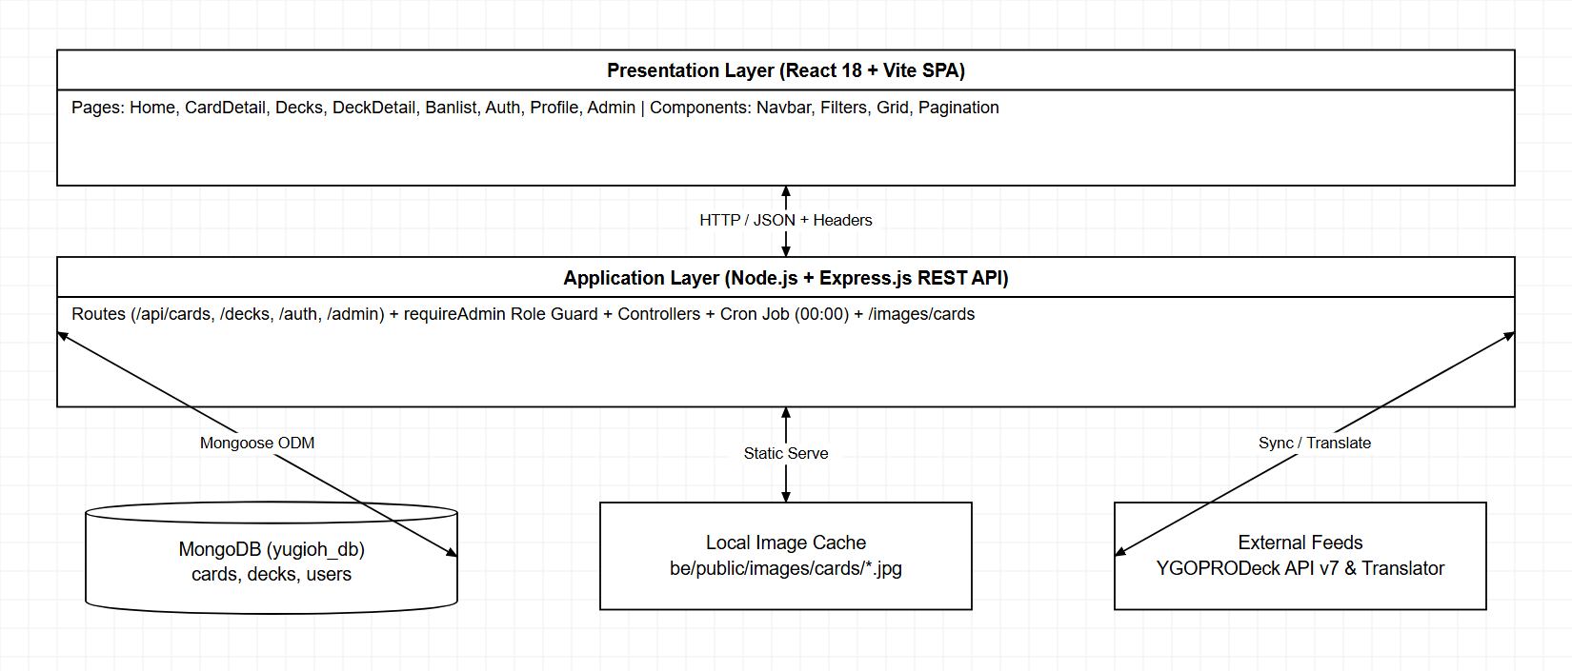
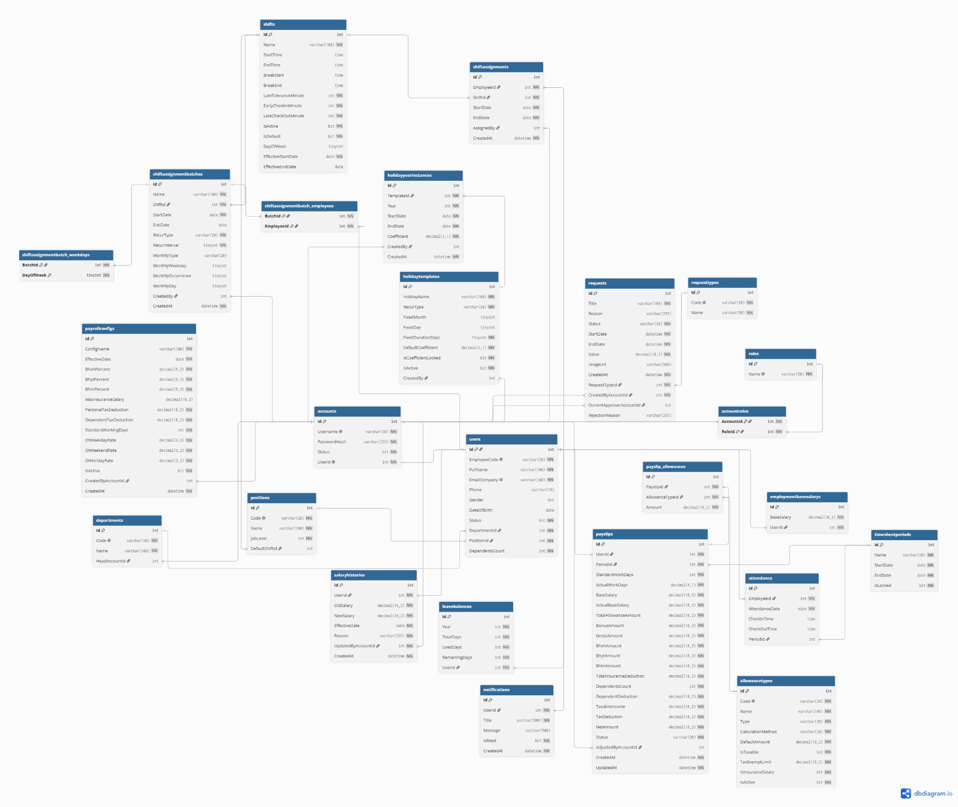
System Design
3-Tier MERN Architecture

Slide 13
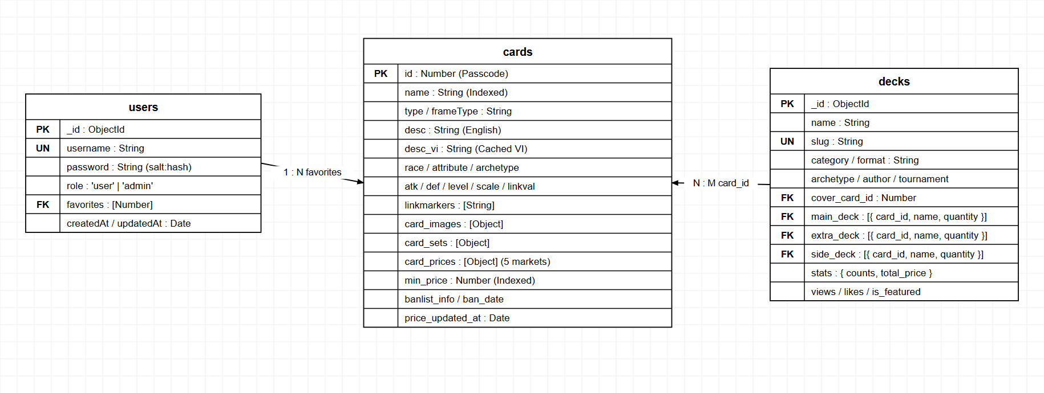
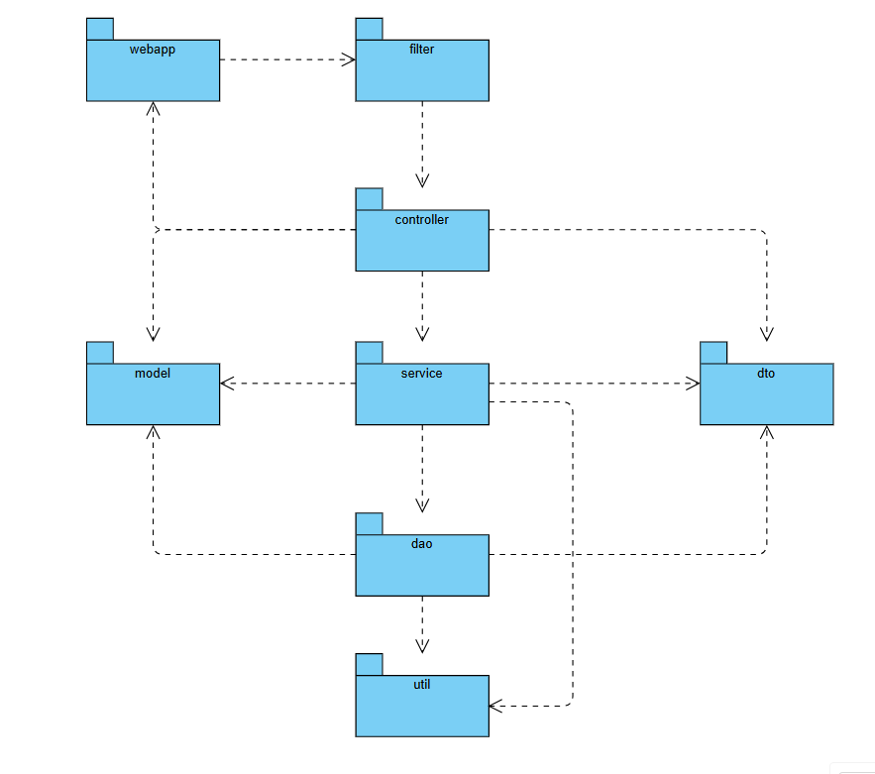
System Design
Database Design (ERD)

Slide 14
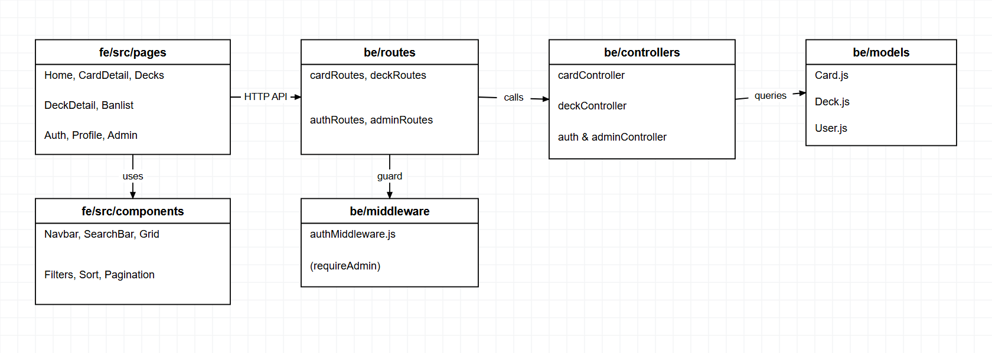
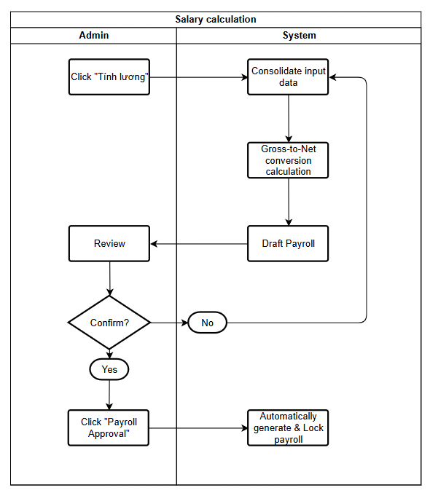
System Design
Package & Dependency Diagram

Slide 15
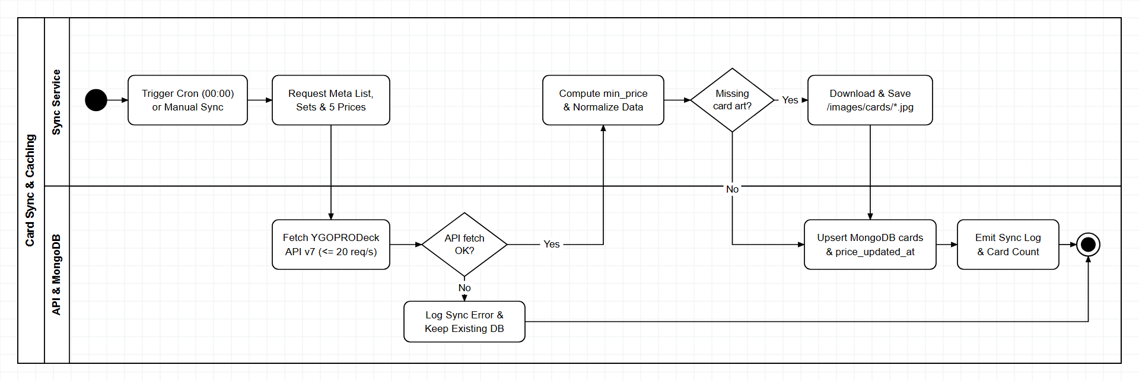
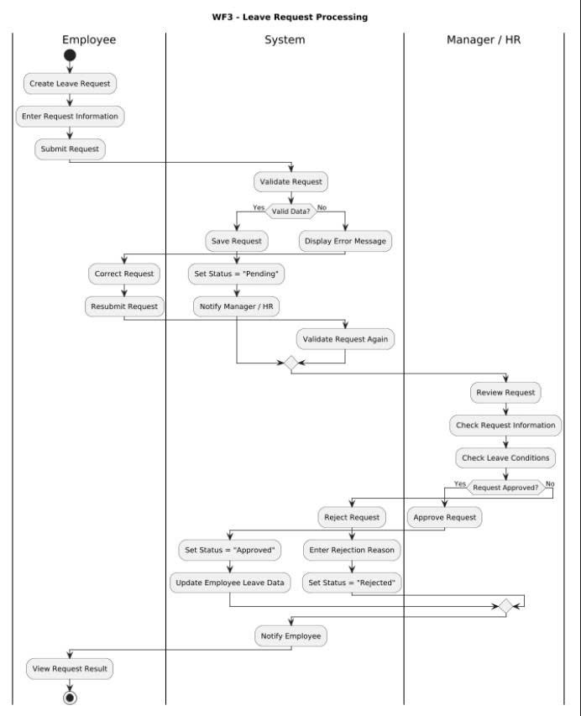
Core Workflows
WF1: Daily Card Sync & Local Caching
Automated Market Synchronization & Image Cache
• Schedule & CLI: Runs daily at 00:00 via node-cron in be/server.js, plus on-demand via npm run sync.
• Price Normalization: Pulls YGOPRODeck v7 payloads, evaluates 5 market prices, and stores lowest min_price.
• Local Assets: Caches artwork under be/public/images/cards/ with serveCardImage on-demand fallback.

Slide 16
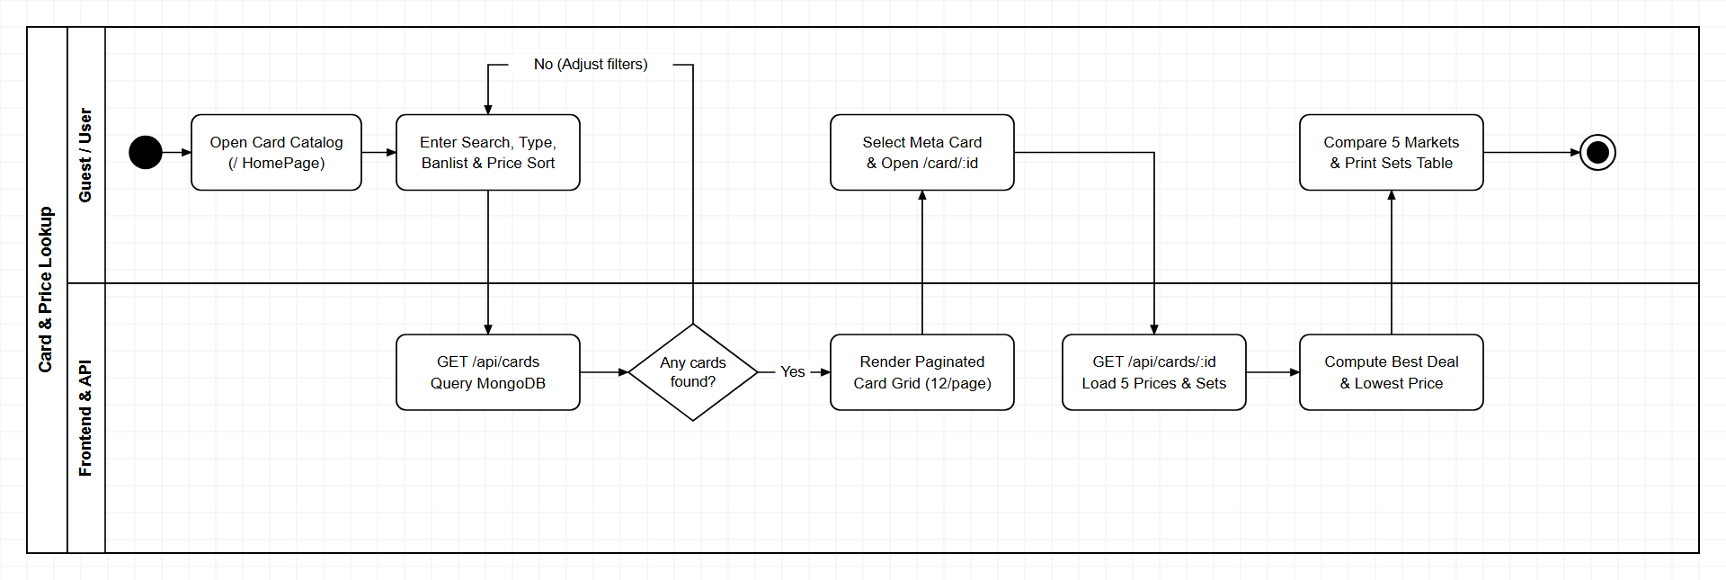
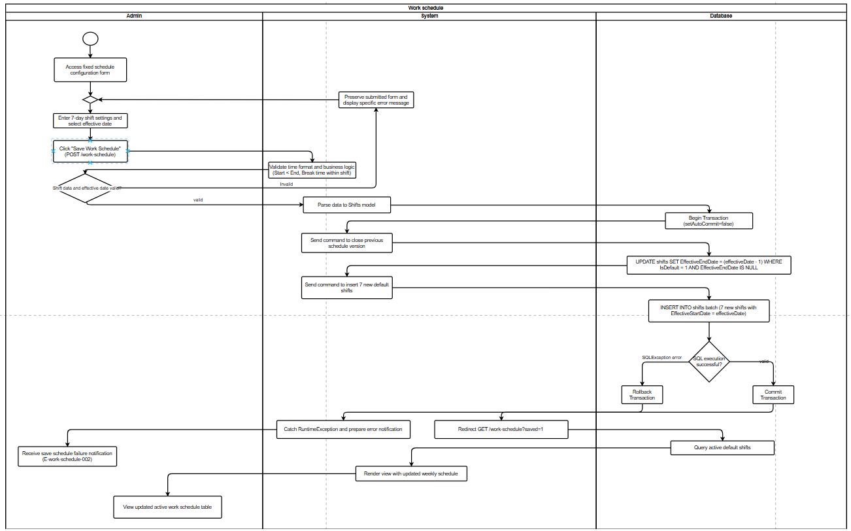
Core Workflows
WF2: Card Lookup & 5-Market Prices
Search, Multi-Filter & Price Comparison
• API Endpoints: GET /api/cards (keyword, type/race/attribute filters, sort, pagination) & GET /api/cards/:id.
• 5-Market Tracking: Compares TCGplayer, Cardmarket, eBay, Amazon, and CoolStuffInc pricing per card.
• Self-Hosted Reliability: Local MongoDB queries and cached images eliminate rate-limit bottlenecks while browsing.

Slide 17
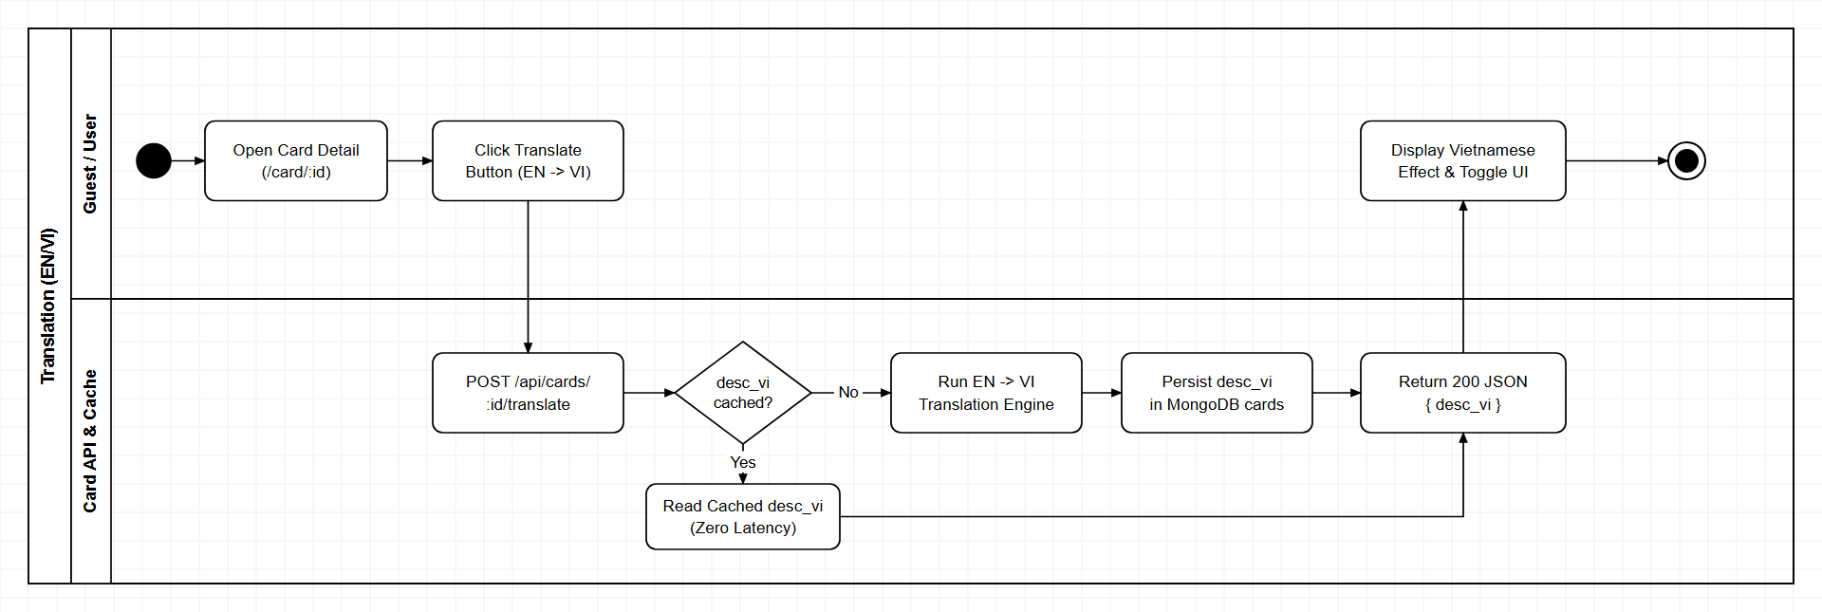
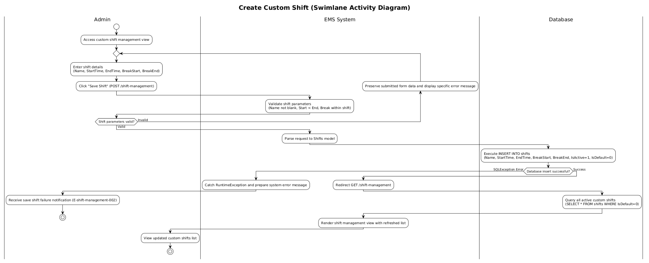
Core Workflows
WF3: Multi-Tier EN/VI Effect Translation
Cache-First Bilingual Effect Translation
• API Endpoint: GET / POST /api/cards/:id/translate (supports ?force=true to bypass cached text).
• Multi-Tier Pipeline: Checks Card.desc_vi first; on miss runs translateToVietnamese(card.desc) PSCT glossaries.
• Database Persistence: Stores generated Vietnamese effect text in Card.desc_vi for instant reuse.

Slide 18
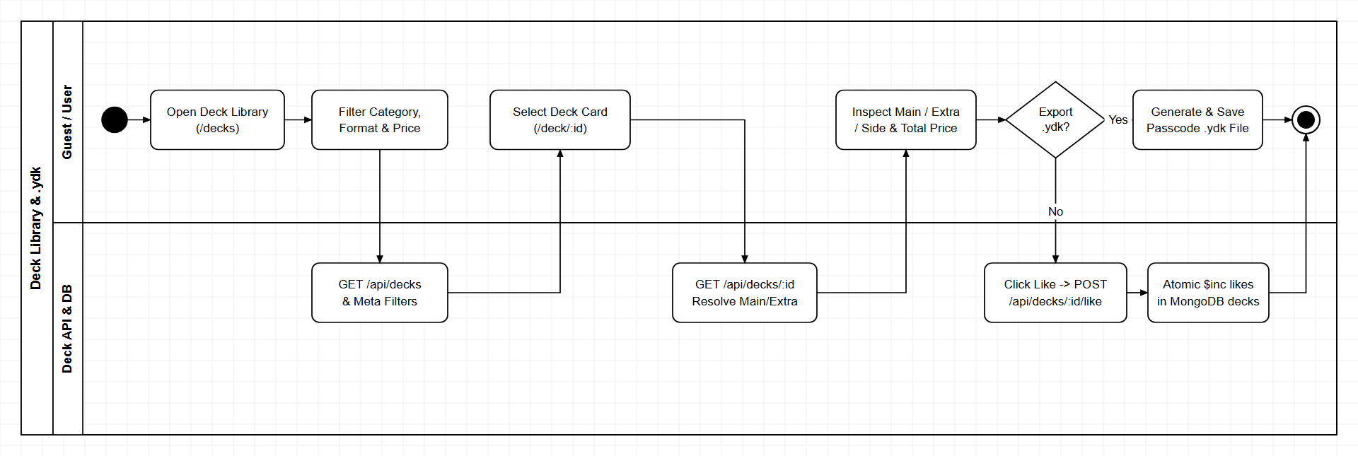
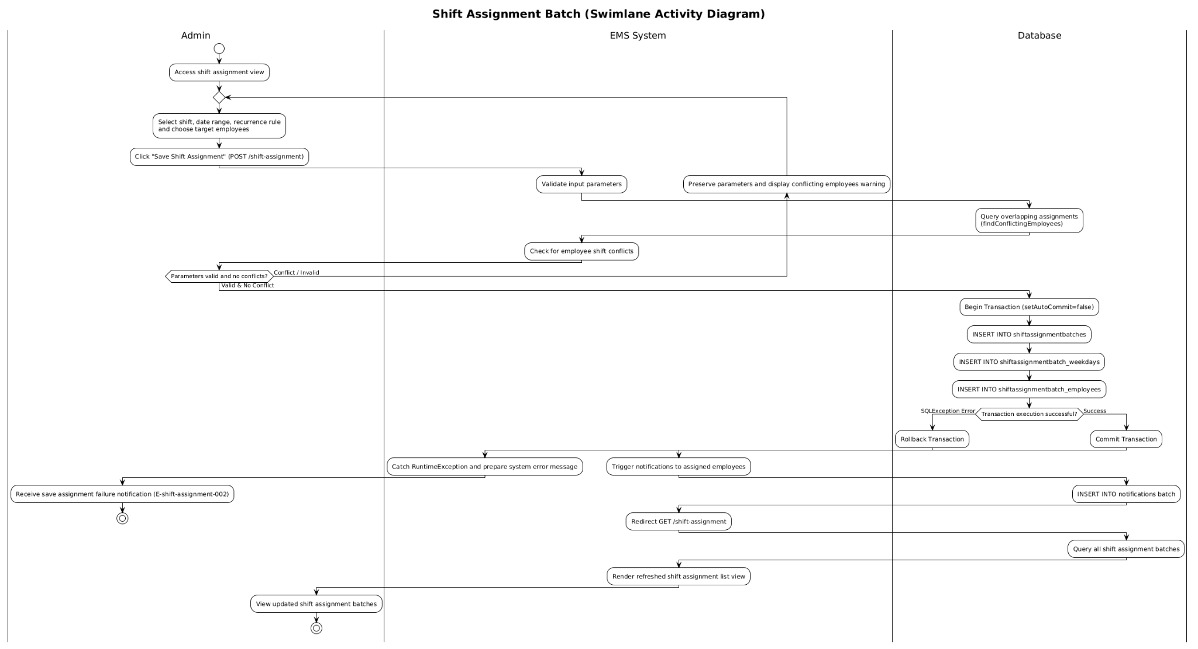
Core Workflows
WF4: Curated Deck Library & .ydk Export
Tournament Decks, Formats & Simulator Export
• API Endpoints: GET /api/decks/meta, GET /api/decks (format/archetype/price filters), GET /api/decks/:id & /like.
• .ydk Export: Client DeckDetailPage builds #main / #extra / !side .ydk files for EDOPro, YGO Omega & DuelingBook.
• Banlist Support: Dedicated banlist filtering (Forbidden, Limited, Semi-Limited) via /api/cards/sample/banned.

Slide 19
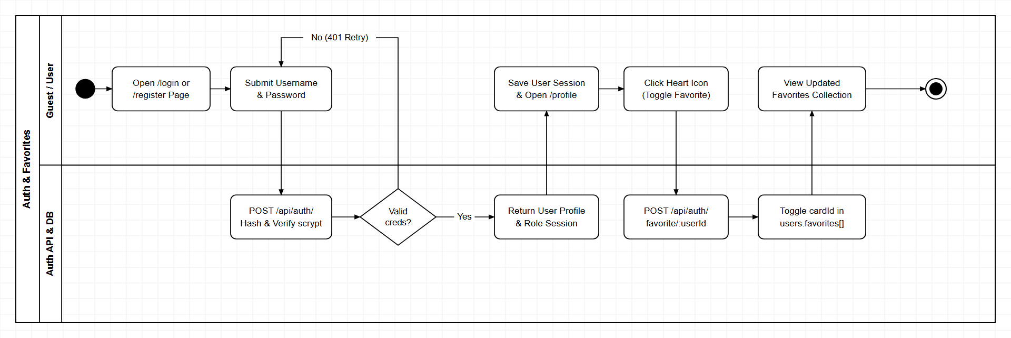
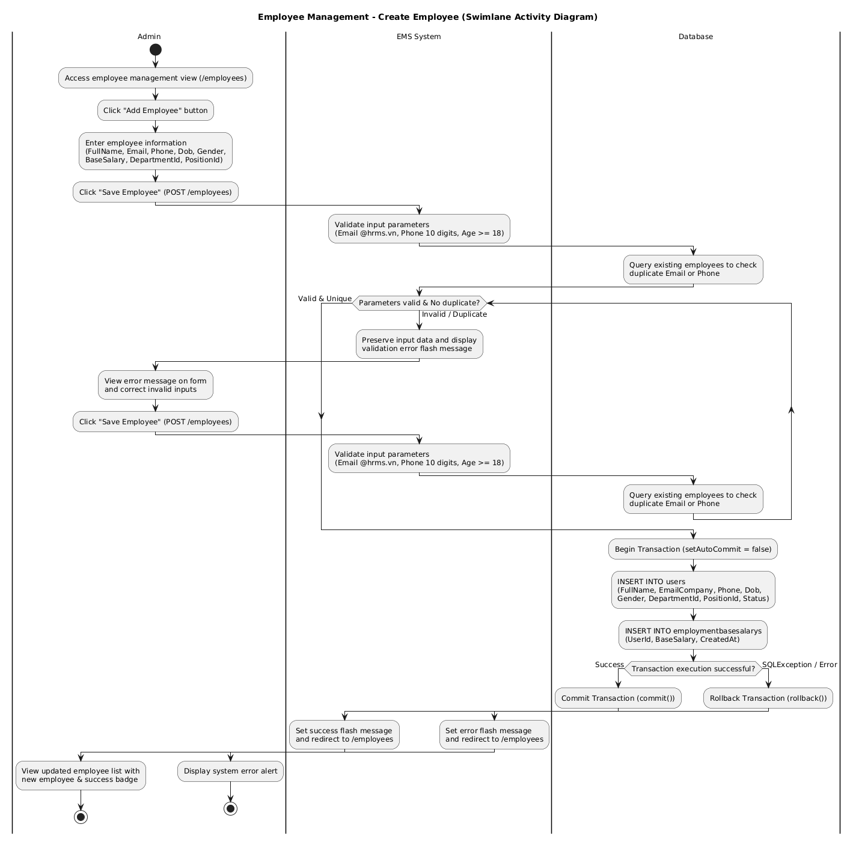
Core Workflows
WF5: Authentication & Personal Favorites
Account Security & Collection Valuation
• Endpoints: POST /api/auth/register, /login, GET /profile/:userId, PUT /change-password/:userId.
• Credential Security: Salted Node crypto.scryptSync (16-byte random salt) verified with crypto.timingSafeEqual.
• Favorites Tracking: POST /api/auth/favorite/:userId updates User.favorites and sums min_price portfolio value.

Slide 20
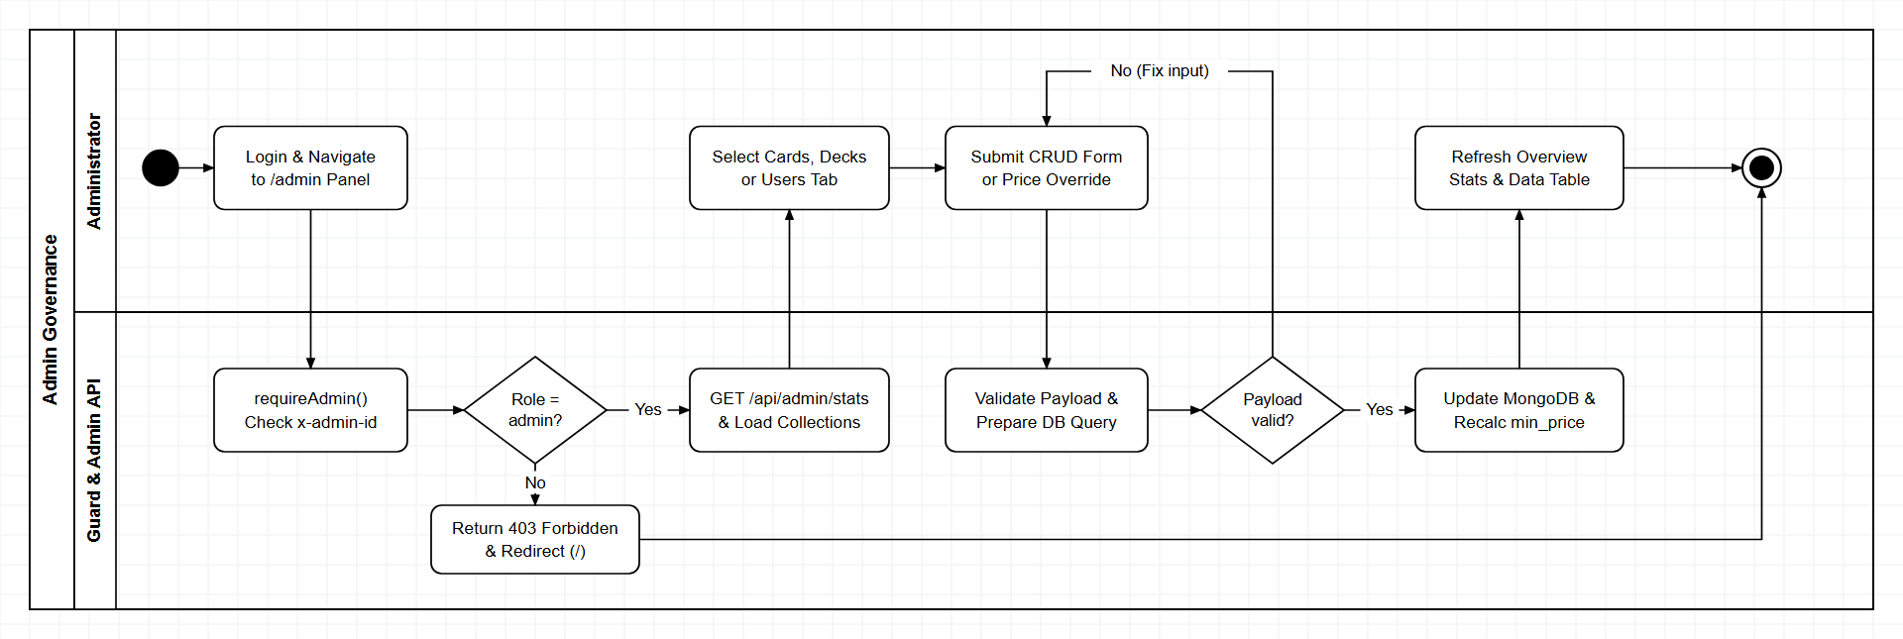
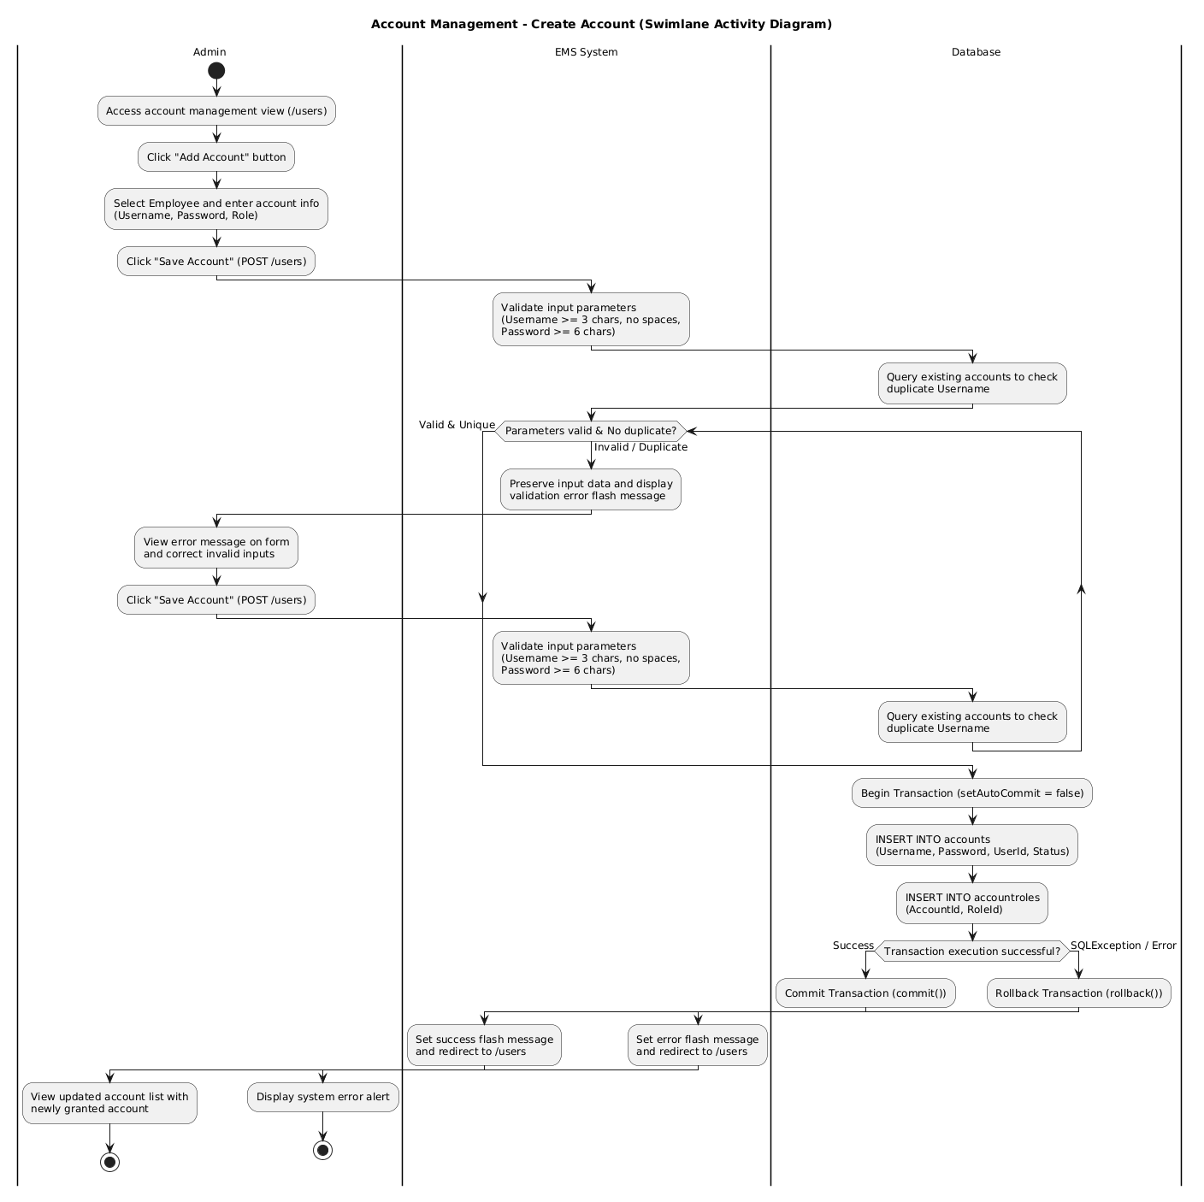
Core Workflows
WF6: Admin Catalog & User Governance
Role-Gated Administration & CRUD Portal
• Access Guard: All /api/admin/* routes apply requireAdmin validating x-admin-id / x-user-id (role === 'admin').
• Catalog & Decks: GET /stats plus full CRUD via /api/admin/cards, /cards/:id/price, and /api/admin/decks.
• User Governance: Manage accounts via GET /api/admin/users, PUT /users/:id/role, and DELETE /users/:id.

Slide 21


